Slide 1
BEST INDIAN CITY FOR CLUBBING
By,
Aniket Kolkar

Slide 2
Introduction:
Clubbing (also known as club culture, related to raving) is the custom of visiting and gathering socially at nightclubs (discotheques, discos or just clubs) and festivals. That includes socializing, listening to music, dancing, drinking alcohol and sometimes using recreational drugs. In most cases it is done to hear new music on larger, high-end audio systems than one would usually have in their home, or for socializing and meeting new people. Clubbing and raves have historically referred to grass-roots organized, anti-establishment and unlicensed all night dance parties, typically featuring electronically produced dance music, such as techno, house, trance and drum and bass.
Our goal is to find the city which is best for clubbing amongst MUMBAI,DELHI,BANGALORE,HYDEREBAD,CHENNAI,KOLKATA
Notes:
Insert a map of your country.

Slide 3
Problem:
To find the answers to the following questions:
Q: To find the best city for clubbing.
Notes:
Insert a picture of one of the geographic features of your country.

Slide 4
Data Section:
I have chosen these cities because they are most populated, education, economic power and being metropolitan. Out of the cities we will choose one. Foursquare API will help us gather data.
Data will consist of all the pubs in the city and we will cluster them and find which city is the best for clubbing.
Notes:
Insert a picture illustrating a season in your country.

Slide 5
Methodology:
Our goal for this project is to search high dense city of PUBS for clubbing. For this I have used Foursquare API through the venues channel. I used the near query to get venues in the cities. Also I have use CategoryID to set it to show only Pubs. In my code you will see the format. That 4bf58dd8d48988d11b941735 is the CategoryId of the Pubs.
Also, Foursquare limits us to maximum of 100 venues per query. Moreover, I repeated this request for the 6 studied cities and got their top 50 venues as all cities don’t have 100 pubs. I saved the name and coordinate data only from the result and plotted them on the map for visual inspection.
Next, to get an indicator of the density of Pubs, I calculated a center coordinate of the venues to get the mean longitude and latitude values. Then I calculated the mean of the Euclidean distance from each venue to the mean coordinates. My indicator was mean distance to the mean coordinate.
Notes:
Insert a picture of an animal and or plant found in your country.

Slide 6
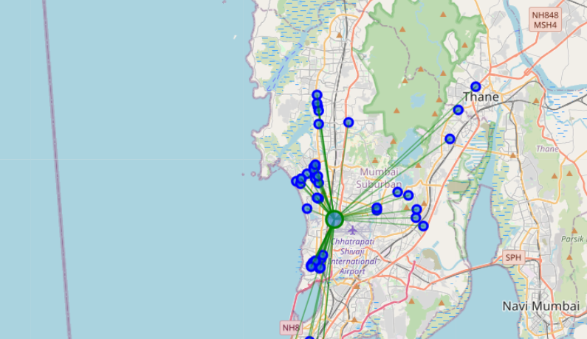
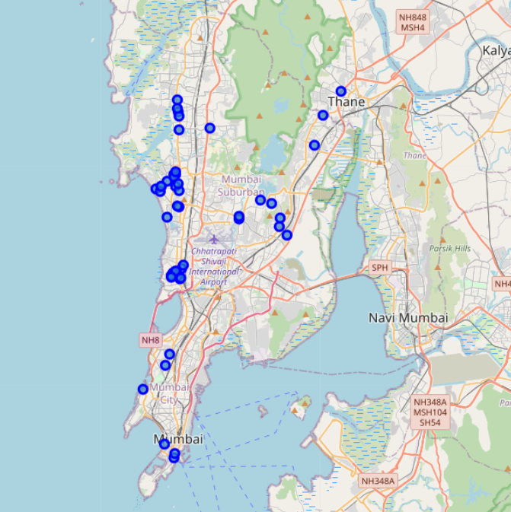
RESULTS: MUMBAI

Slide 7
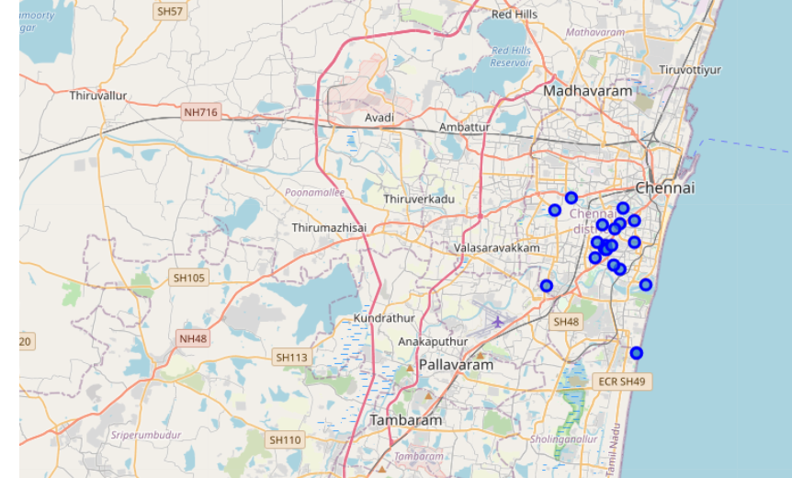
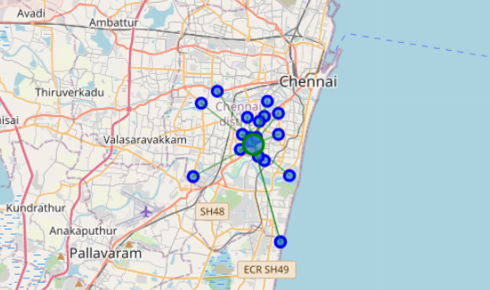
CHENNAI

Slide 8
Conclusion:
So now we can answer the questions asked above in the Question section:
Answers:
From above table we can say that Chennai is highly dense Indian city for clubbing.
City | Mean Distance from Mean coordinates
Mumbai | 0.06421550502055165
Bangalore | 0.032792551583881585
Delhi | 0.051193078255594875
Kolkata | 0.029498604021180097
Chennai | 0.023503977678797618
Hyderabad | 0.030618277446070707
Notes:
Add key points in the history of your country to the timeline.

